Slide 1

DISTRIBUTED AMAZON SIMPLEDB
DESMEND PHILIPS
KRISTINA WHITE
FRANCIS ASOMANING

Slide 2
INTRODUCTION
A distributed database is a database that consists of two or more files located on different sites either on the same network or on entirely different networks. Portions of the database are stored in multiple physical locations and processing is distributed among multiple database nodes.
Detailed summary of distributed database
Amazon simpleDB
Features
Amazon SimpleDB Concepts

Slide 3
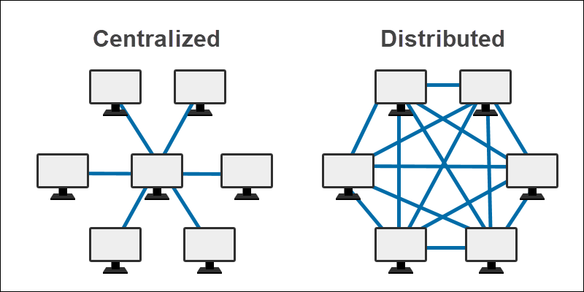
Some differences between distributed and centralized
DISTRIBUTED | CENTRALIZED
CONSISTS OF MULTIPLE DATABASE FILES LOCATED AT DIFFERENT SITES | CONSISTS OF A SINGLE, CENTRAL DATABASE FILE
ALLOWS MULTIPLE USERS TO ACCESS AND MANIPULATE DATA | BOTTLENECKS WHEN MULTIPLE USERS ACCESS THE SAME FILE SIMULTANEOUSLY
IF ONE SITE FAILS, DATA IS RETRIEVABLE | SINGLE SITE MEANS DOWNTIME IN CASES OF SYSTEM FAILURES

Slide 4
REASON FOR THE CREATION OF DISTRIBUTED DATABASE
Distributed databases offer location transparency of data with local autonomy. This means that even though applications might not know where exactly the data resides, each site has the capability to control local data, administer security, keep track of transactions and recover when local site failures occur.

Slide 5
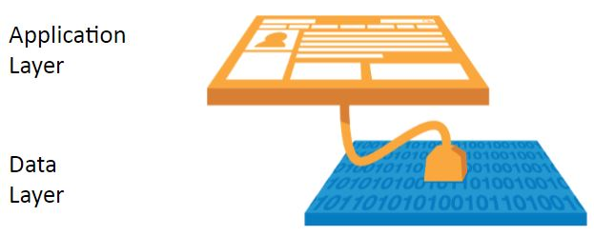
When to use a distributed database vs relational
In general, distributed databases include the following features: Location independent, Distributed query processing, Distributed transaction management, Hardware independent, Operating system independent, Network independent, and Transaction transparency.
Distributed databases are used by corporations that have numerous offices or companies in different locations. Typically, an individual branch interacts primarily with the data that pertain to its own operations, with a much less frequent need for general company data.
With relational databases organizations store predictable, structured data with a finite number of individuals accessing it. It also offers a level of maturity and widespread support that remains unrivaled by NoSQL alternatives.

Slide 6
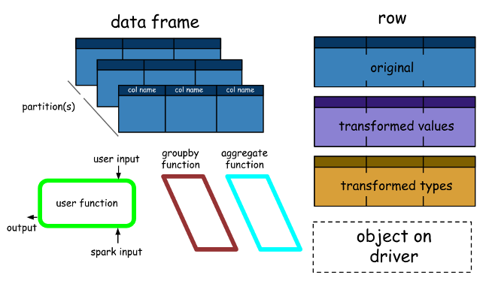
Distributed database architecture
Advantages of distributed Database
When failures occur in centralized databases, the system comes to a complete stop. When a component fails in distributed database systems, however, the system will continue to function at reduced performance until the error is fixed
Corporations can achieve lower communication costs for distributed database systems if the data is located close to where it is used the most. This is not possible in centralized systems.
Disadvantages:
Although distributed DBMS is capable of effective communication and data sharing, it still suffers from various disadvantages
In a Distributed Database, along with maintaining no data redundancy, the security of data as well as a network is a prime concern. A network can be easily attacked for data theft and misuse.

Slide 7
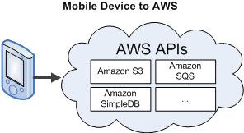
Examples of Distributed Database
There are many distributed databases to choose from, some examples of distributed databases include
Apache Ignite,
Apache Cassandra,
Apache HBase,
Couchbase Server,
Cluster point,
FoundationDB ETC.
But our main focus is on Amazon SimpleDB.

Slide 8

Amazon SimpleDB
Amazon SimpleDB is a web service for running queries on structured data in real-time. This service works in close conjunction with Amazon Simple Storage Service (Amazon S3) and Amazon Elastic Compute Cloud (Amazon EC2), collectively providing the ability to store, process, and query data sets in the cloud. These services are designed to make web-scale computing easier and more cost-effective for developers.

Slide 9
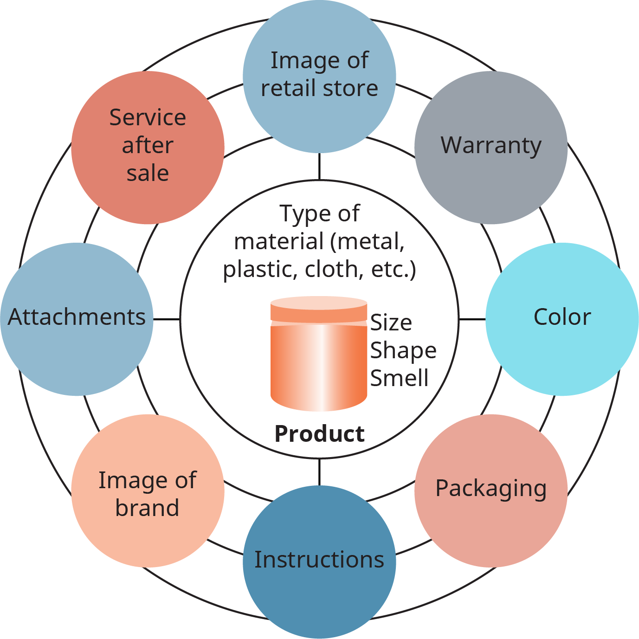
Amazon SimpleDB attributes/Performance
Simple to use—Amazon SimpleDB provides streamlined access to the lookup and query functions that traditionally are achieved using a relational database cluster while leaving out another complex, often-unused database operations.
Scalable—Amazon SimpleDB allows you to easily scale your application. You can quickly create new domains as your data grows or your request throughput increases.
Fast—Amazon SimpleDB provides quick, efficient storage and retrieval of your data to support high-performance web applications.
Flexible—With Amazon SimpleDB, it is not necessary to pre-define all of the data formats you will need to store; simply add new attributes to your Amazon SimpleDB data set when needed, and the system will automatically index your data accordingly.
Inexpensive—Amazon SimpleDB passes on to you the financial benefits of Amazon's scale. You pay only for resources you actually consume.

Slide 10

Pricing for Amazon SimpleDB
Amazon SimpleDB pricing is based on your actual usage. Your usage is measured and rounded up to the nearest cent. You are charged for the following types of usage:
Structured Data Storage—Measures the size of your billable data by adding the raw byte size of the data you upload + 45 bytes of overhead for each item, attribute name, and attribute-value pair.
Data Transfer—Measures the amount of data transferred for every operation. Data transferred between Amazon SimpleDB and other Amazon Web Services (e.g., Amazon S3, Amazon EC2, Amazon SQS, and others) is free of charge.
Machine Utilization—Measures the machine utilization of each request and charges based on the amount of machine capacity used to complete the particular request (SELECT, GET, PUT, etc.).

Slide 11
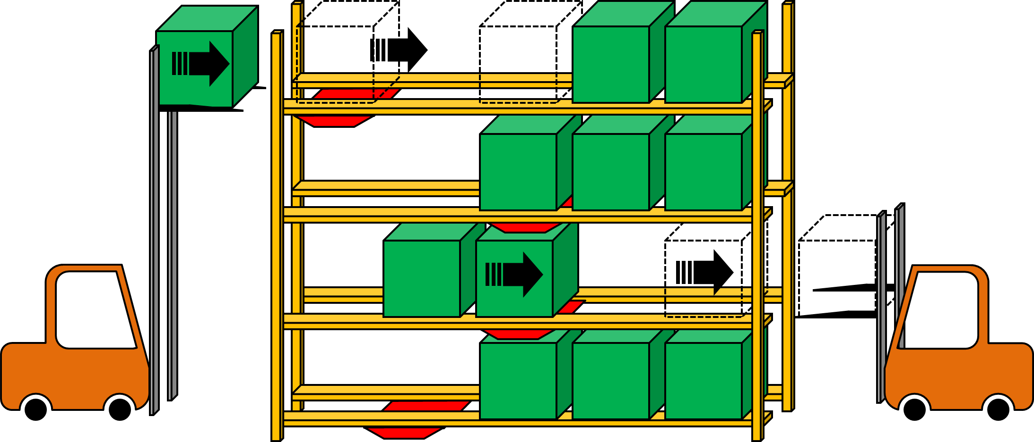
Storage and Transfer
You are charged for the amount of storage your data uses each month which can be considered an average of the month. For example, if you use one gigabyte for the month, you are charged for one gigabyte of storage. If you use zero gigabytes for the first half of the month and two gigabytes for the second half, you are also charged for one gigabyte of storage.
Amazon charges you for the amount of data transferred into and out of Amazon SimpleDB. For every operation, Amazon SimpleDB monitors the amount of data sent and received and records the data. Once per hour, the usage total is recorded in your account. This information is stored and totaled at the end of the billing cycle.

Slide 12
Amazon SimpleDB Concepts
• Data Model
• Operations
• API Summary
• Consistency
• Limits
• Data Set Partitioning
• AWS Identity and Access Management

Slide 13

Data model and operation
When using Amazon SimpleDB, you organize your structured data in domains within which you can put data, get data or run queries. Domains consist of items that are described by attribute name-value pairs. Below is the spreadsheet model
.
Operations
The following describes the components of Amazon SimpleDB operations.
Subscribe-Any application, script, or software making a call to the Amazon SimpleDB service.
Amazon SimpleDB Request—A single web service API call and its associated data that the subscriber sends to the Amazon SimpleDB service to perform one or more operations.
Amazon SimpleDB Response—The response and any results returned from the Amazon SimpleDB service to the subscriber after processing the request.

Slide 14
API Summary and Consistency
The Amazon SimpleDB service consists of a small group of API calls that provide the core functionality needed to build applications.
Create Domain
Delete Domain
List Domain
Put Attribute
BatchPutAttribute
Delete Attribute
BatchDeleteAttribute
Get Attribute
Select
DomainMetadata

Slide 15
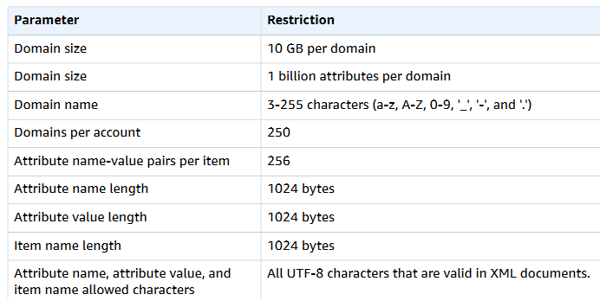
Limits
Following is a table that describes current limits within Amazon SimpleDB.

Slide 16
Data Set Partitioning
Amazon SimpleDB is designed to support highly parallel applications. To improve performance, you can partition your dataset among multiple domains to parallelize queries and have them operate on smaller individual datasets. Although you can only execute a single query against a single domain, you can perform aggregation of the result sets in the application layer. The following is a list of applications that lend themselves to parallelized queries
Natural Partition-The data set naturally partitions along some dimension
High-Performance Application—Useful when the application requires higher throughput than a single domain can provide
Large Data Set—Useful when timeout limits are reached because of the data size or query complexity.

Slide 17
Comparison
In a distributed database, a lot of data communication takes place owing to the diversified location of data, users, and transactions. So it demands secure communication between users and databases and between the different database environments. Data should not be corrupted during transfer.
Authentication and authorization- These are the access control measures adopted to ensure that only authentic users can use the database.
Compared to Big Data, much to other forms of cybersecurity, The big data variant is concerned with attacks that originate either from online or offline spheres.
Some common security tool is encryption- encrypted data is useless to hackers if they don’t have the key to unlock it. Meaning both input and output information is completely protected.

Slide 18

Questions

Slide 19
REFERENCES
https://dl.acm.org/doi/abs/10.1145/320128.320129
https://docs.aws.amazon.com/AmazonSimpleDB/latest/DeveloperGuide/Operations.html
HAMMEa, M.M., AND SHIPMAN, D.W. The reliability mechanisms of SDD-I: A system for distributed databases. Submitted for publication
https://www.techtarget.com/searchoracle/definition/distributed-database
https://www.sciencedirect.com/topics/computer-science/distributed-databases

